Slide 1
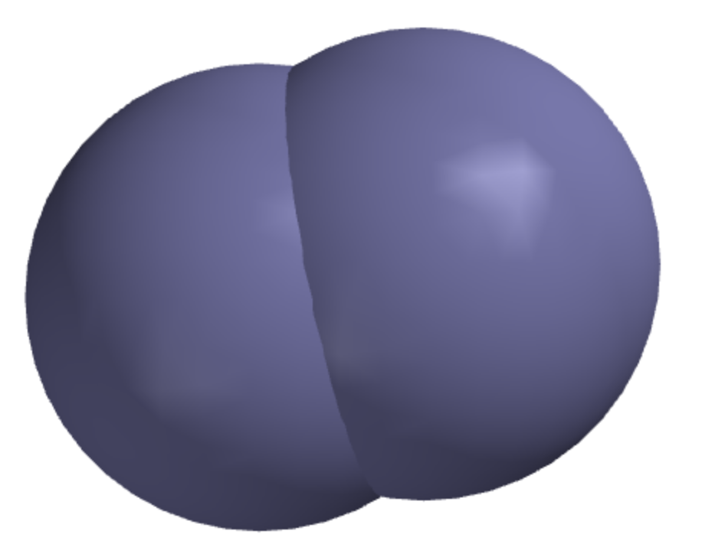
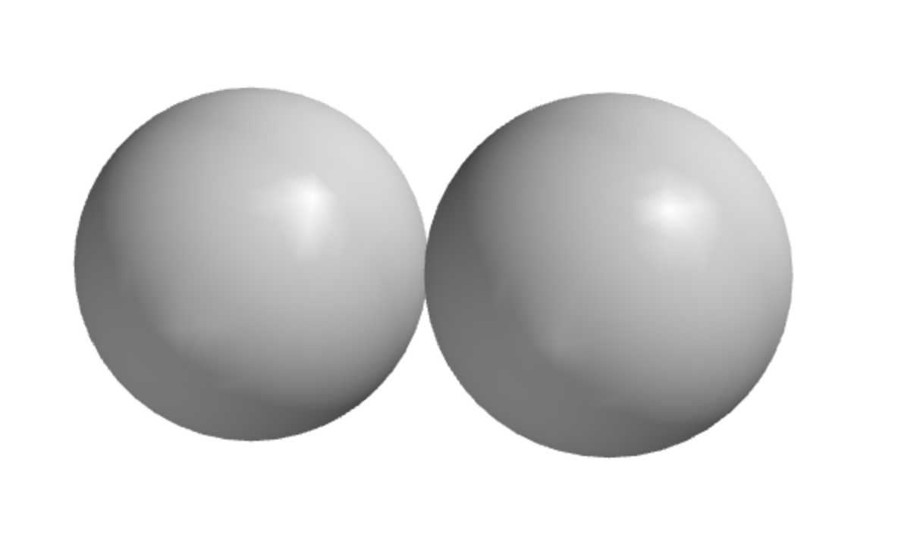
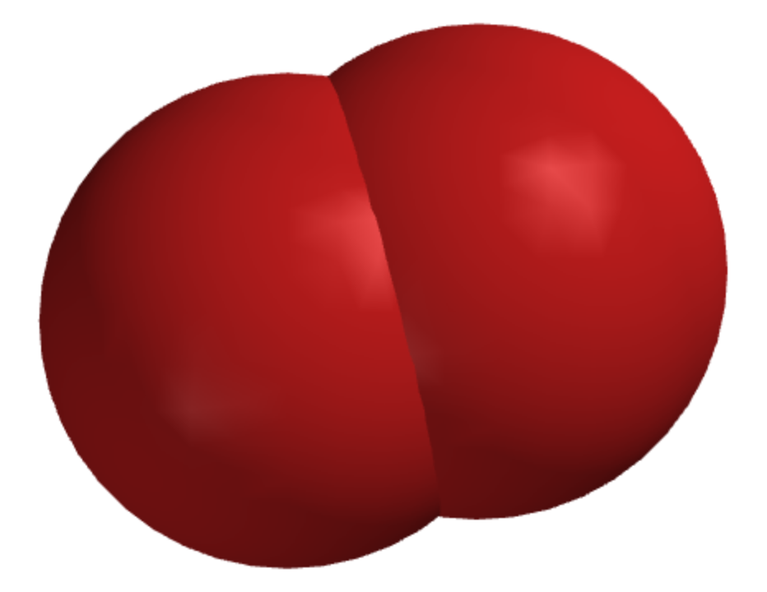
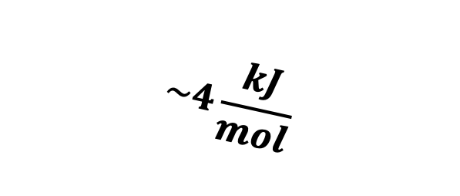
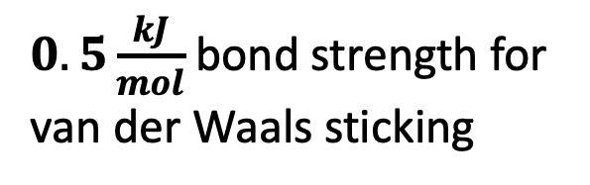
Ordinary collisions (with N₂ or O₂) will separate atoms that are just “stuck”
$$\sim 4\frac{kJ}{mol}$$
$0.5\frac{kJ}{mol}$ bond strength for van der Waals sticking

Slide 2
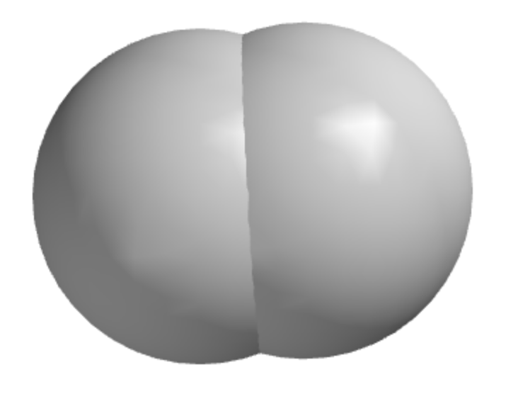
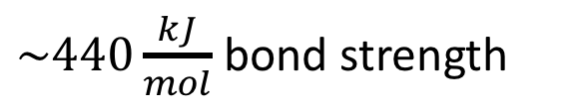
But there’s no way simple collisions will separate covalently bonded atoms
$$\sim 4\frac{kJ}{mol}$$
$\sim 440\frac{kJ}{mol}$ bond strength

Slide 3
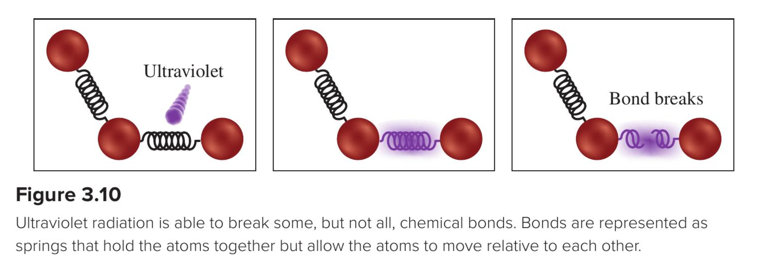
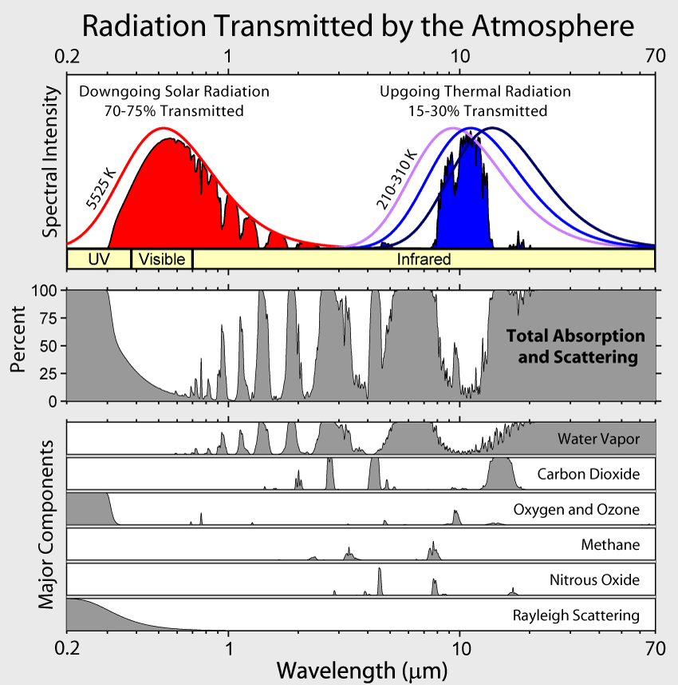
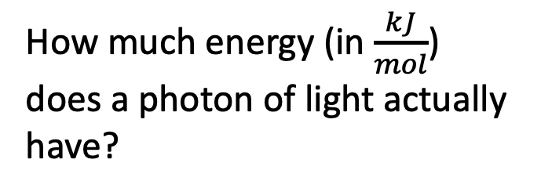
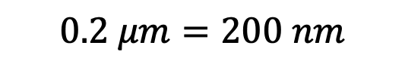
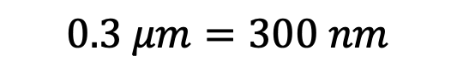
But some kinds of light can break covalent bonds!
How much energy (in $\frac{kJ}{mol}$) does a photon of light actually have?
$$0.3 μm=300 nm$$
$$0.2 μm=200 nm$$

Slide 4
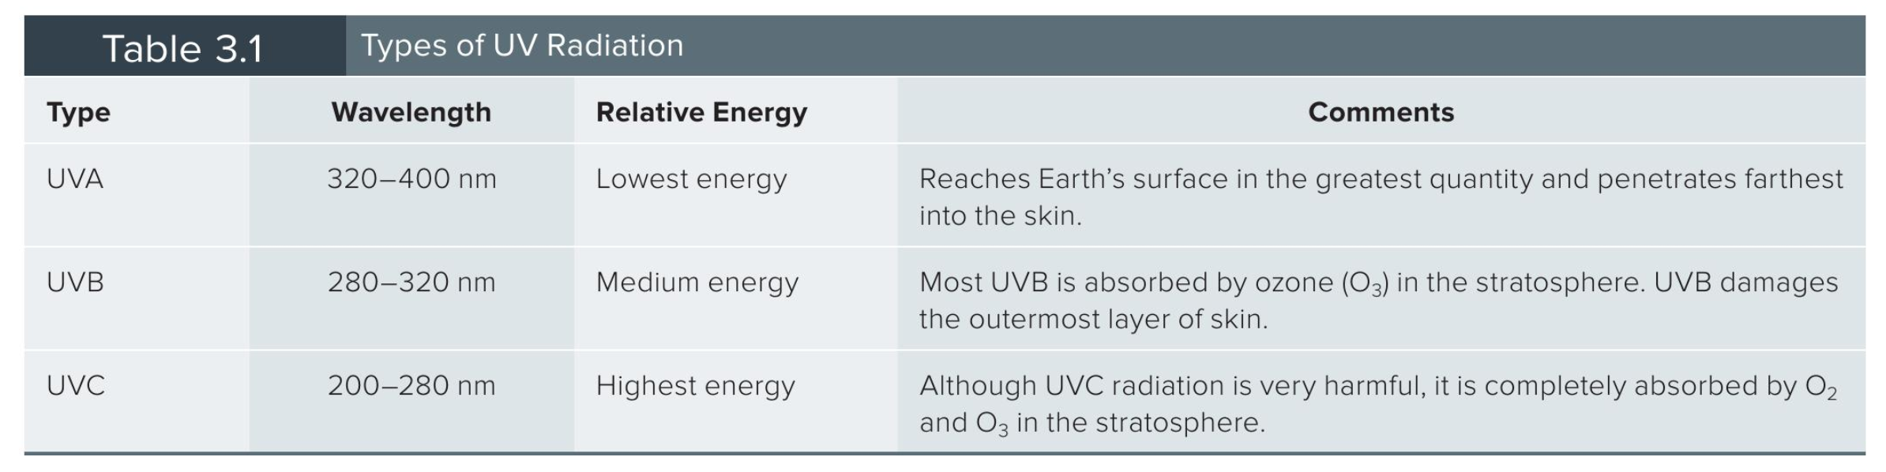
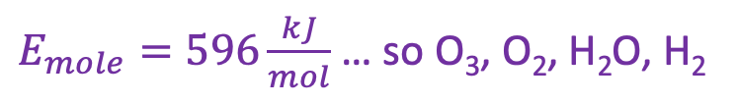
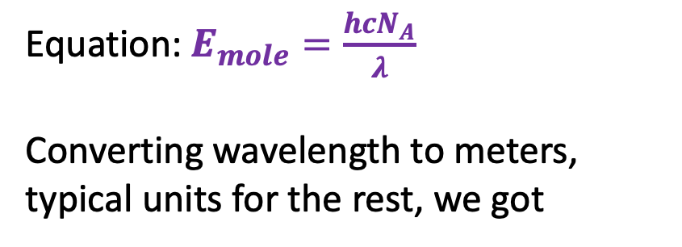
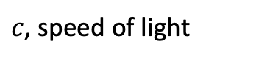
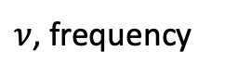
Breaking bonds with photons
Equation: $E_{mole}=\frac{hcN_{A}}{λ}$
Converting wavelength to meters, typical units for the rest, we got
$c$, speed of light
$ν$, frequency
$E_{mole}=596\frac{kJ}{mol}$ … so O₃, O₂, H₂O, H₂

Slide 5
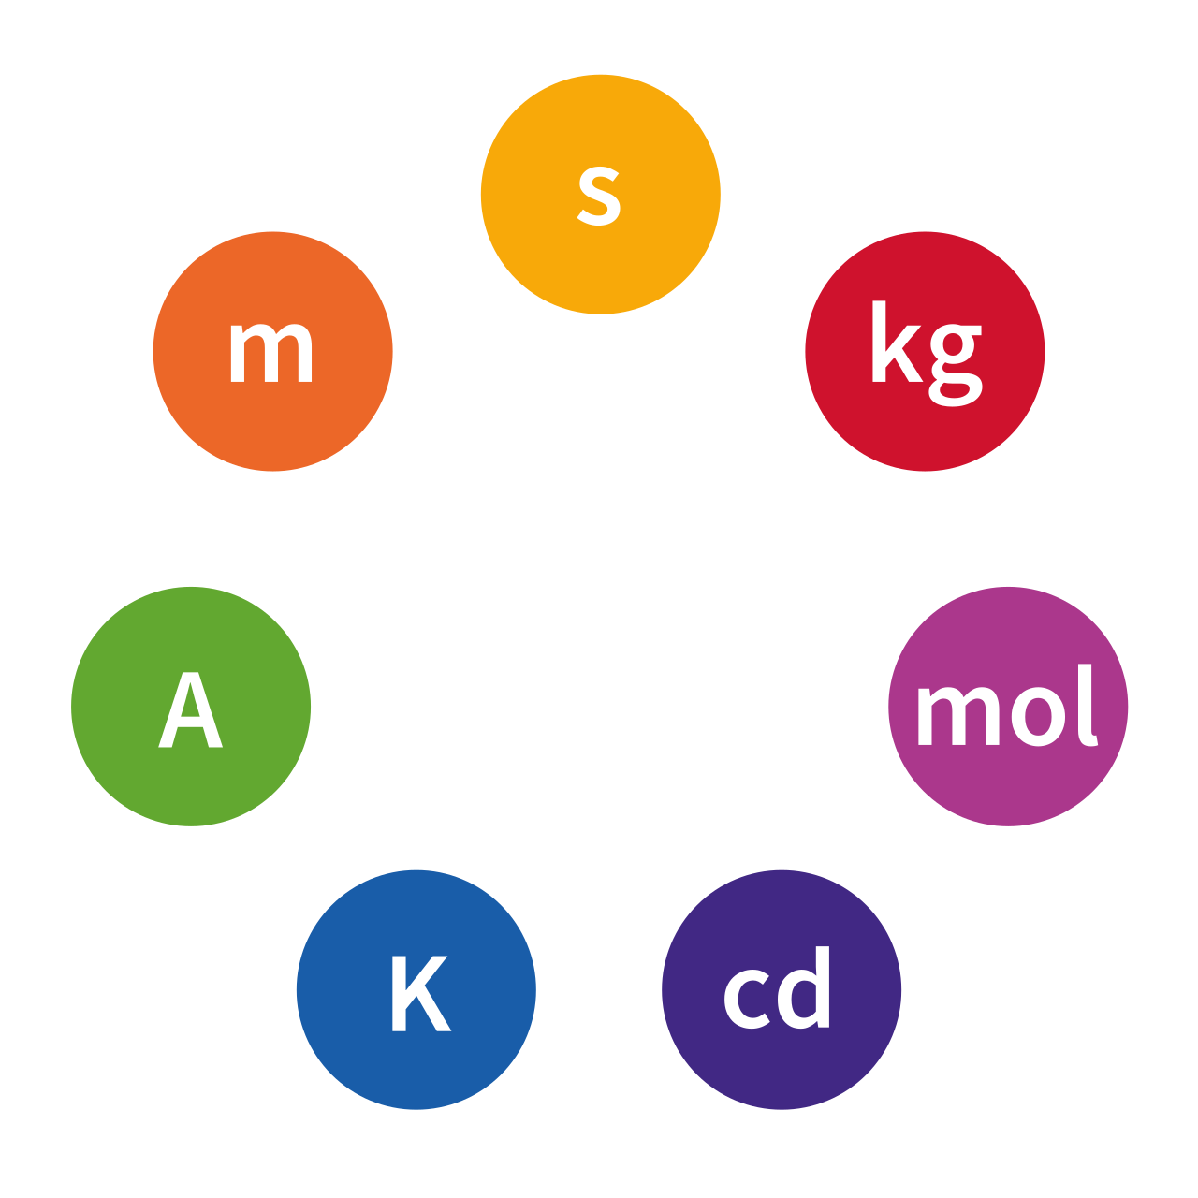
SI units
SI base units:
Meters
Seconds
Kilograms
Degrees
Moles
Derived unit we need to know about:
Joules (unit of energy):
1 J = kg⋅m²⋅s⁻²

Slide 6
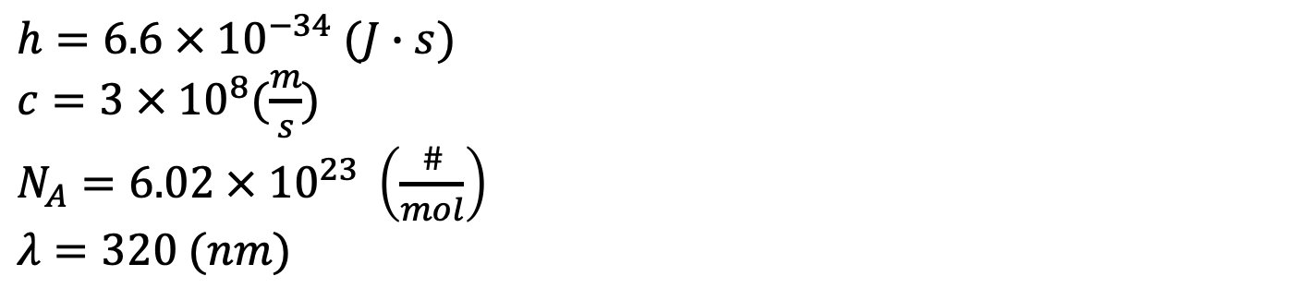
Breaking bonds - the unit challenge
$c$, speed of light
$ν$, frequency
Your next challenge has to do with identifying all the quantities in $E_{mole}=\frac{hcN_{A}}{λ}$ as SI or not SI (and fixing if the latter).
$h=6.6 × {10}^{−34} (J∙s)$
$c=3 × {10}^{8}(\frac{m}{s})$
$N_{A}=6.02 × {10}^{23} \left(\frac{\#}{mol}\right)$
$λ=320 (nm)$

Slide 7
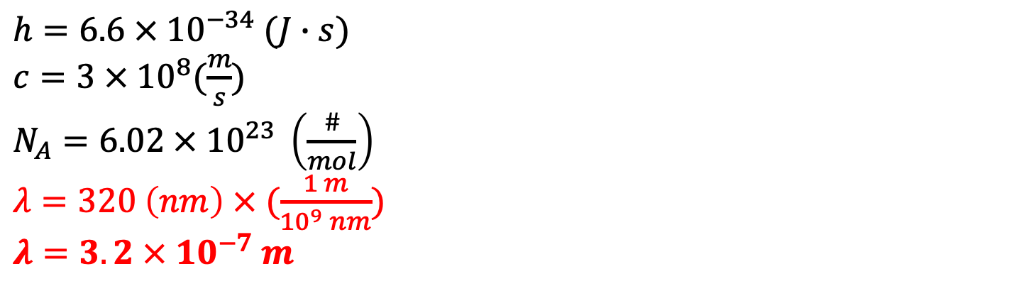
Breaking bonds - the unit challenge
$c$, speed of light
$ν$, frequency
Your next challenge has to do with identifying all the quantities in $E_{mole}=\frac{hcN_{A}}{λ}$ as SI or not SI (and fixing if the latter).
$h=6.6 × {10}^{−34} (J∙s)$
$c=3 × {10}^{8}(\frac{m}{s})$
$N_{A}=6.02 × {10}^{23} \left(\frac{\#}{mol}\right)$
$λ=320 \left(nm\right) × (\frac{1 m}{{10}^{9} nm})$
$λ=3.2 × {10}^{−7} m$

Slide 8
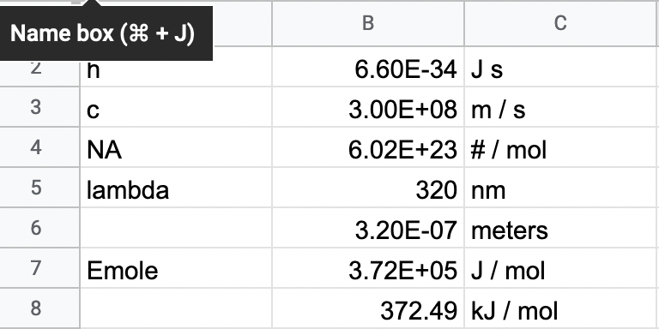
Breaking bonds - the unit challenge
$c$, speed of light
$ν$, frequency
Your next challenge has to do with identifying all the quantities in $E_{mole}=\frac{hcN_{A}}{λ}$ as SI or not SI (and fixing if the latter).
$h=6.6 × {10}^{−34} (J∙s)$
$c=3 × {10}^{8}(\frac{m}{s})$
$N_{A}=6.02 × {10}^{23} \left(\frac{\#}{mol}\right)$
$λ=320 \left(nm\right) × (\frac{1 m}{{10}^{9} nm})$
$λ=3.2 × {10}^{−7} m$

Slide 9
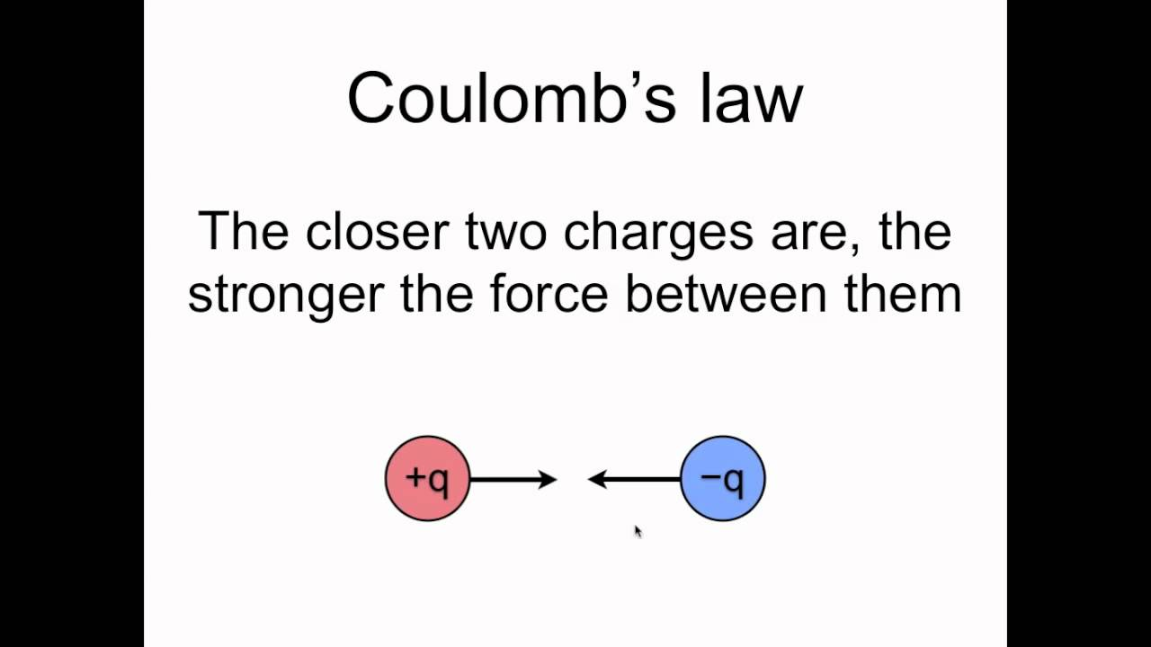
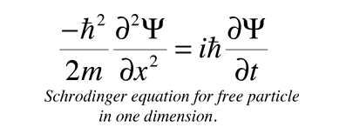
The challenge of understanding covalent bonding
Coulomb’s Law – the idea that oppositely charged particles (like a nucleus and an electron) are attracted to each other, while like charges (like two nuclei or two electrons) are repelled from one another. Fortunately, qualitative ideas get us pretty far ….
Schrödinger’s Equation – a way for us to predict where the electrons on an atom or molecule go. Fortunately, we have Spartan to solve this equation for us …

Slide 10
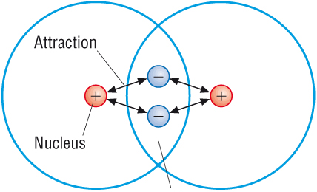

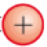
How Coulomb’s Law plays a role in covalent bonding
Here, two hydrogen atoms are at their van der Waals distance – their shells don’t overlap much.
H
H
Here, two hydrogen atoms are at their covalent bonding distance; their shells definitely overlap. A consequence of shell overlap: Electrons in the overlap region (like here) are attracted to both nuclei (“cross-Coulombic attraction”). This means it will cost energy to pull them apart
H
H

Slide 11
A caveat about this picture … the electron cloud is still a cloud
Slightly more probable position of an electron

Slide 12
A caveat about this picture … the electron cloud is still a cloud
Slightly more probable position of an electron
Possible position of an electron

Slide 13
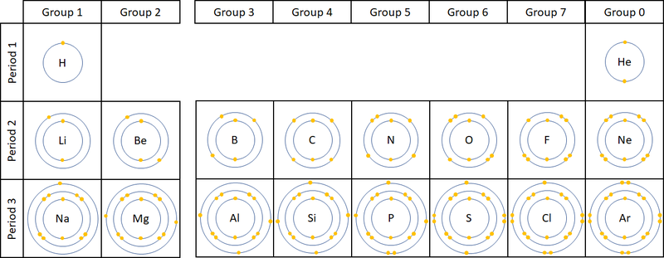
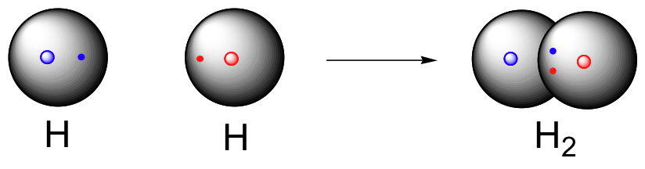
Cross-Coulombic attractions require unfilled shells
Since each of these H-atoms has an unfilled shell, an electron from the other H-atom has access to that space

Slide 14
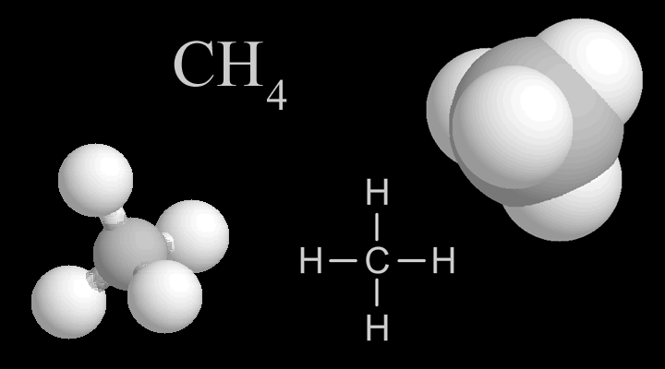
Cross-Coulombic attractions require unfilled shells
Since each H-atom has an unfilled shell, electrons from the C-atom have access to that space.
Since the C-atom has an unfilled shell, electrons from the H-atoms have access to it’s space.

Slide 15
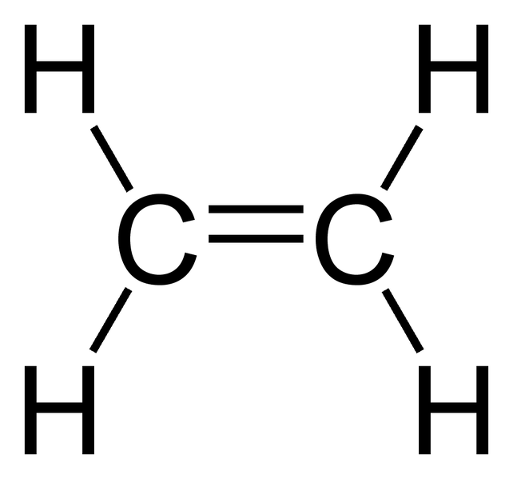
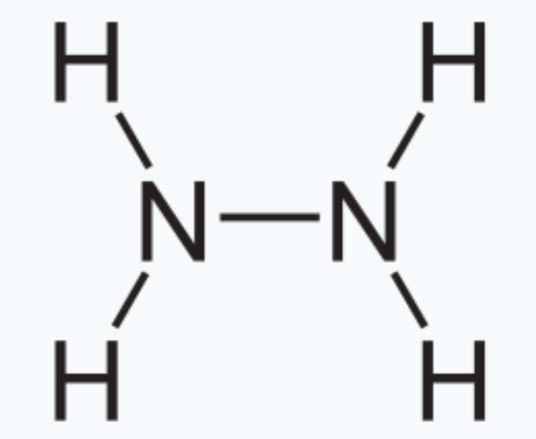
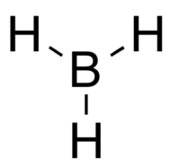
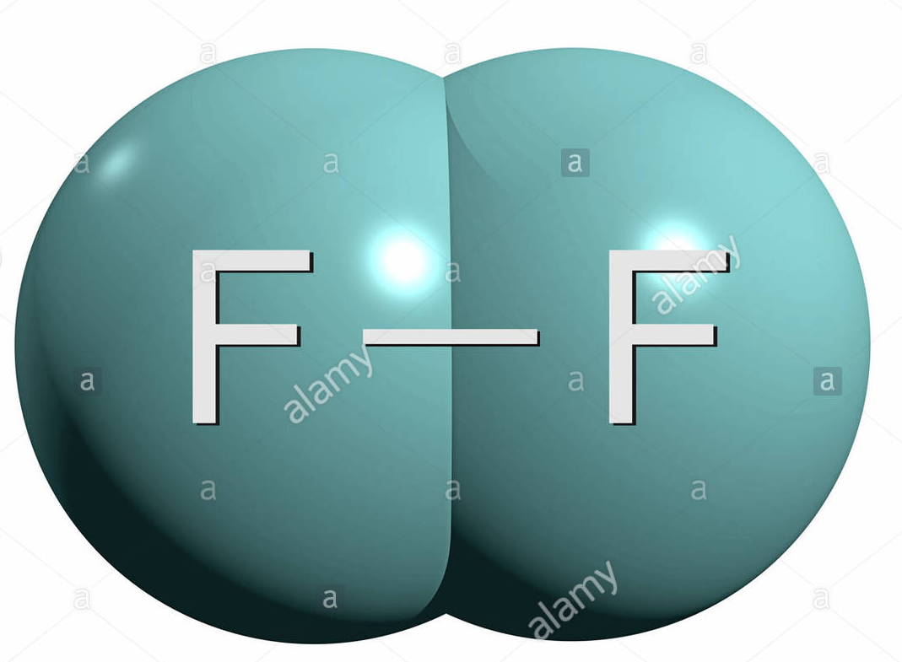
Most atoms have unfilled shells, so susceptible to covalent bonding
Group 0 elements (Noble gases) don’t have room in their shells for cross-coulombic attractions → Less likely to bond with other atoms

Slide 16
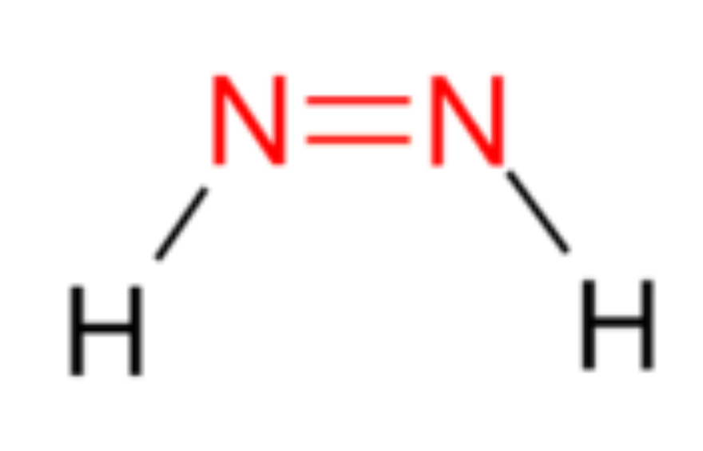
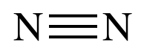
We learned to make Structural Formulas and Lewis Structures
The lines indicate covalent bonds (two electrons)
W/o dots, they’re Structural Formulas
When we add dots, they become Lewis Structures

Slide 17
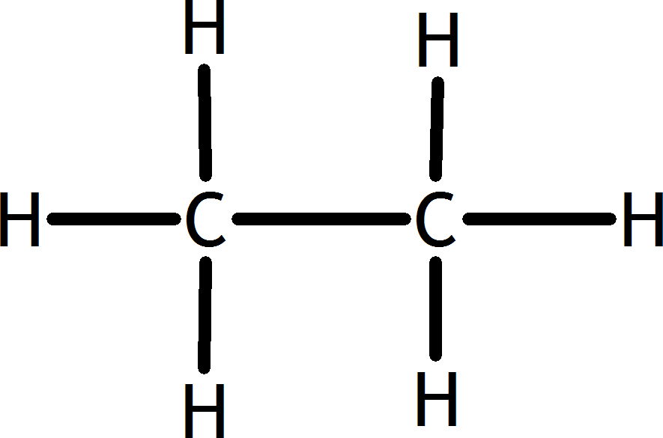
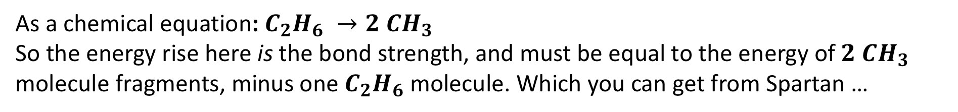
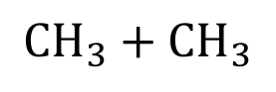
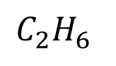
Bond Strength and Reaction Progress Diagrams
$${CH}_{3}+{ CH}_{3}$$
This diagram is called a Reaction Progress Diagram
Energy
$$C_{2}H_{6}$$
Reaction Progress
As a chemical equation: $C_{2}H_{6} →2 CH_{3}$
So the energy rise here is the bond strength, and must be equal to the energy of $2 CH_{3}$ molecule fragments, minus one $C_{2}H_{6}$ molecule. Which you can get from Spartan …

Slide 18
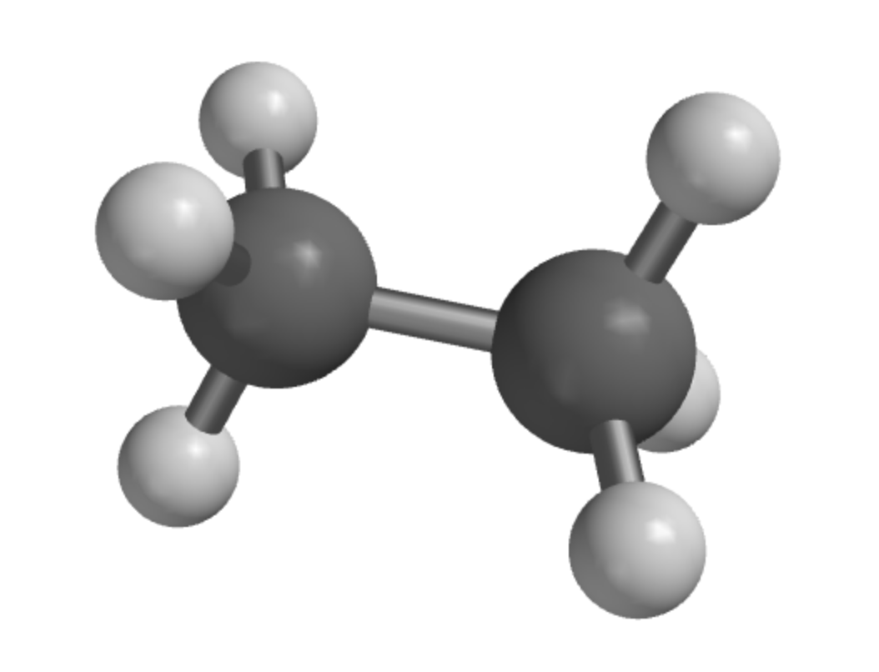
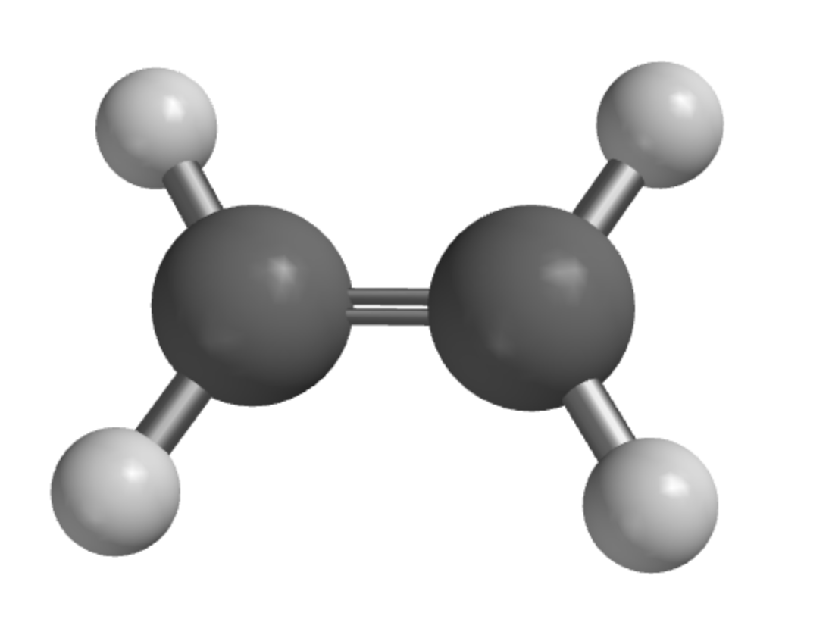
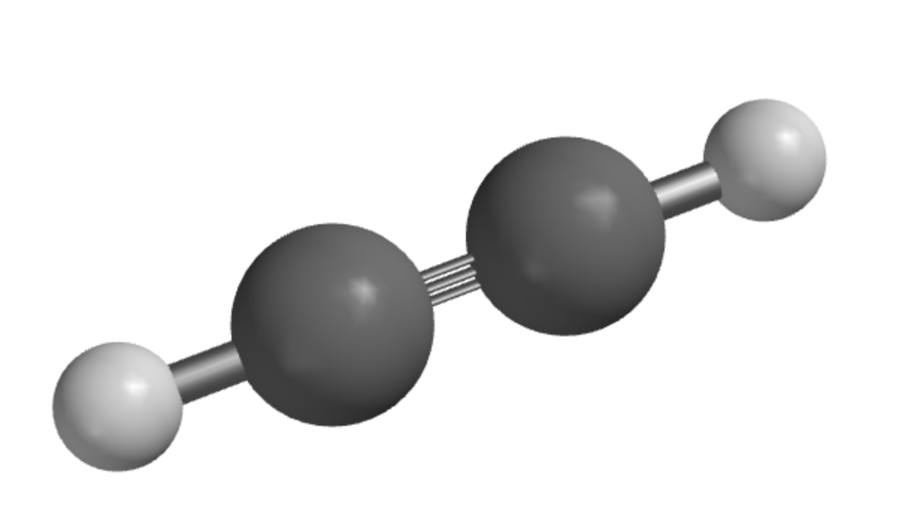
Correlation between bond order, bond strength, and bond length
Higher bond order (between carbon atoms)
Stronger C-C bonds
Shorter bond lengths
https://openstax.org/books/chemistry-atoms-first-2e/pages/9-4-strengths-of-ionic-and-covalent-bonds

Slide 19
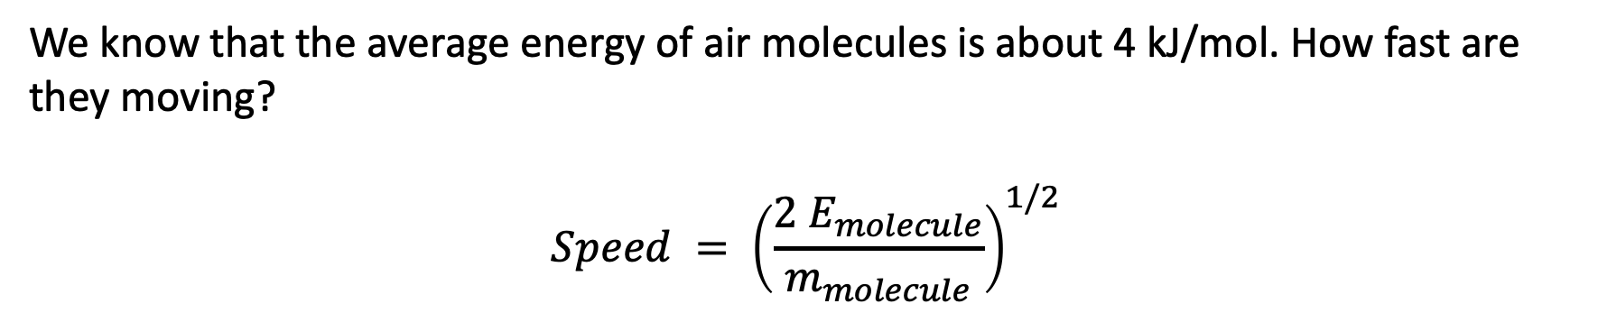
SI units
SI base units:
Meters
Seconds
Kilograms
Degrees
Moles
Derived unit we need to know about:
Joules (unit of energy):
1 J = kg⋅m²⋅s⁻²
We know that the average energy of air molecules is about 4 kJ/mol. How fast are they moving?
$$Speed = {\left(\frac{2 E_{molecule}}{m_{molecule}}\right)}^{1/2}$$

